Slide 1

CONTENTS
01
02
03
Problem Statement and Objective
Process Workflow
Structure of Data Sources
04
05
06
Visualization Stories
Prediction of Risk Factors
Challenges and Conclusion

Slide 2
Problem Statement and Objective
Problem Statement:
Az National Trucking (ANT), a long-distance trucking corporation based in California, is facing
an uptick in the number of traffic incidents and a subsequent increase in the cost of vehicle
insurance within its fleet. The primary challenges are related to drivers' non-compliance with
safety regulations and unsafe driving practices, including speeding, unsafe following distances, lane departure, and other hazardous behaviors. These incidents threaten the company’s
reputation, financial stability, and the safety of drivers, other road users, and cargo.
Business Objective:
We would like to identify hazardous truck drivers in California by analyzing the truck
fleet dataset for risk factors that significantly contributed to the increasing number of traffic incidents
By visualizing the dataset and identifying risk factors with a value of 7.0 or greater,
we would like to offer a personalized solution to ANT through our analysis

Slide 3
Process Workflow
Download Files
Move files from Local server to VMware Local server
Move files from VMware Local to HDFS
Create tables and load data into the tables in Impala
Connect Impala and Tableau using Impala ODBC Driver
Integrate Tableau and R
Visualize the data using Tableau
Notes:
Step 1: Download Files Begin by downloading the required files from the source. These files contain the data that needs to be processed and visualized.
Step 2: Move Files from Local Server to VMware Local Server Next, transfer the downloaded files from the local server to the VMware Local Server. This step ensures that the data is accessible within the virtual environment.
Step 3: Move Files from VMware Local to HDFS After the files are in the VMware Local Server, proceed to move them to the Hadoop Distributed File System (HDFS). This step makes the data available for processing and analysis within the Hadoop ecosystem.
Step 4: Create Tables and Load Data into Impala Create the necessary tables in Impala that match the data schema. Once the tables are set up, load the data from HDFS into these Impala tables for efficient querying and analysis.
Step 5: Connect Impala and Tableau using Impala ODBC Driver Establish a connection between Impala and Tableau using the Impala ODBC Driver. This allows Tableau to interact with the data stored in Impala and create visualizations based on the queried results.
Step 6: Integrate Tableau and R Integrate R with Tableau to leverage R's advanced statistical and analytical capabilities. This integration enables the use of R scripts and functions within Tableau to perform complex calculations and data manipulations.
Step 7: Visualize the Data using Tableau Now that the data is loaded into Impala and integrated with R, use Tableau's intuitive and powerful visualization tools to create compelling visualizations and dashboards. Analyze the data, gain insights, and present the findings effectively using Tableau's visual representation capabilities.
By following this workflow, you can effectively download, process, analyze, and visualize data using a combination of VMware, HDFS, Impala, Tableau, and R, thereby enabling a comprehensive data analysis pipeline.

Slide 4
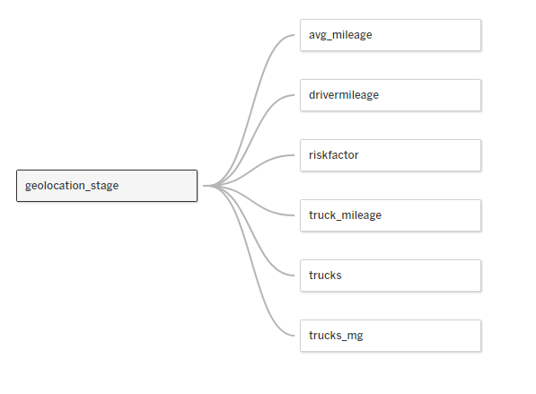
Structure of Data Sources

Slide 5
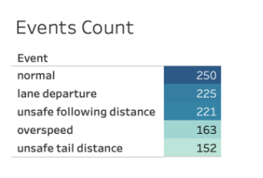
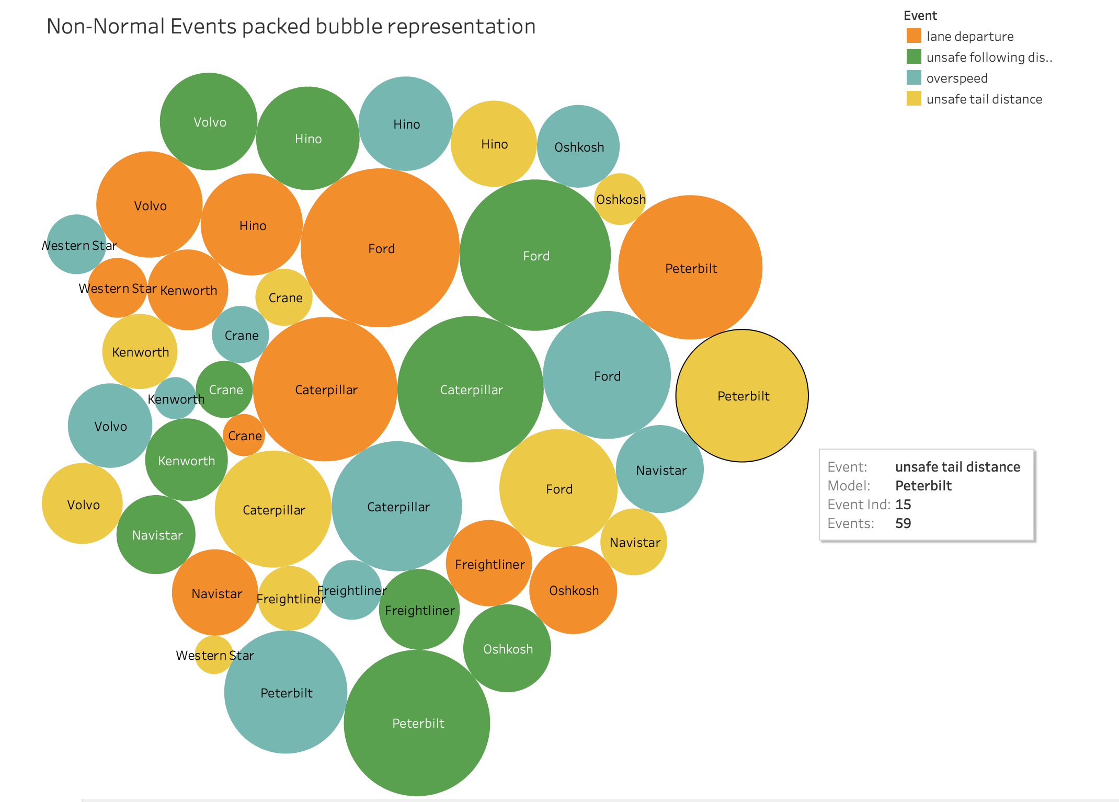

Story 1: Event detailing
This is the breakdown of events occurring:
Normal events: 250
Non-normal events: 761
The top 3 non-normal events:
Lane Departure
Unsafe Following Distance
Overspeed

Slide 6
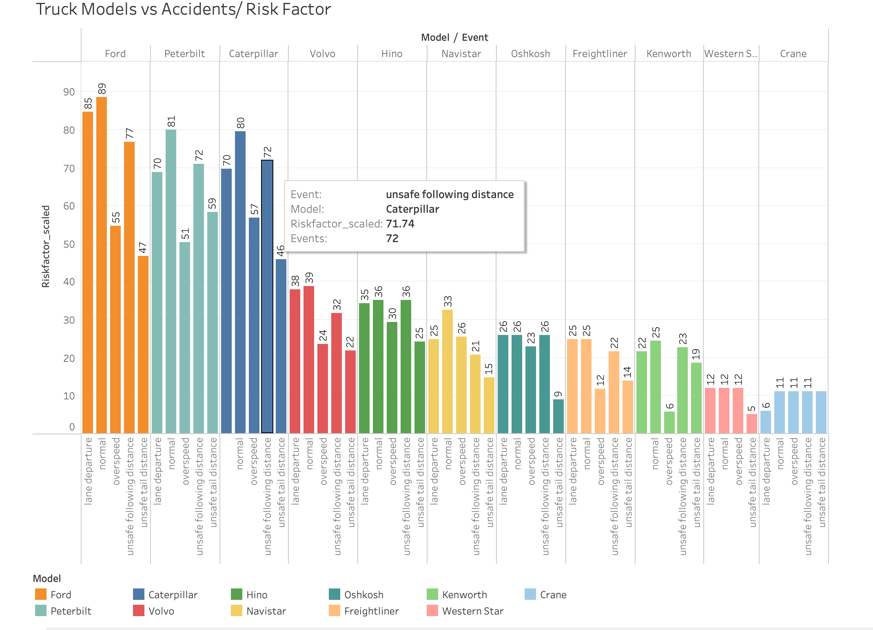
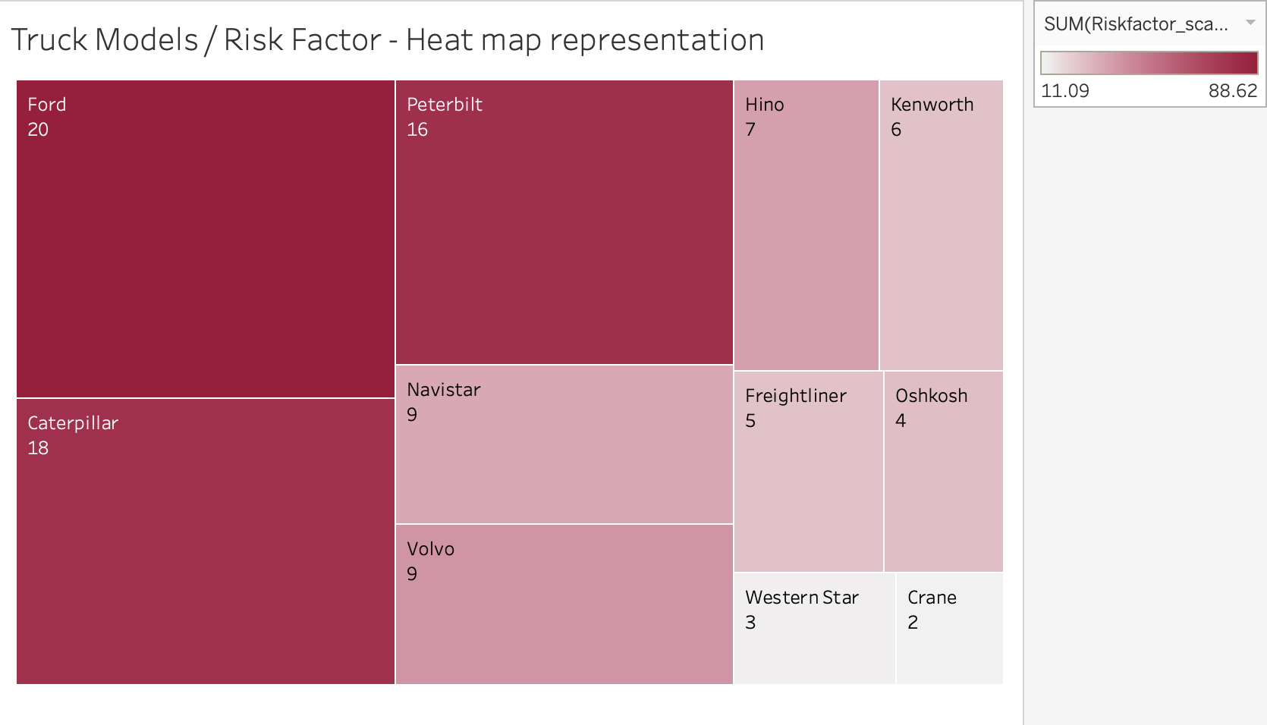
Story 2: Truck models that have the most significant impact on events with a high-Risk Factor.
The top 3 models contributing to events:
Ford - 89
Peterbilt - 81
Caterpillar - 80
Ford possesses the highest Risk Factor, which
stands at 20.

Slide 7
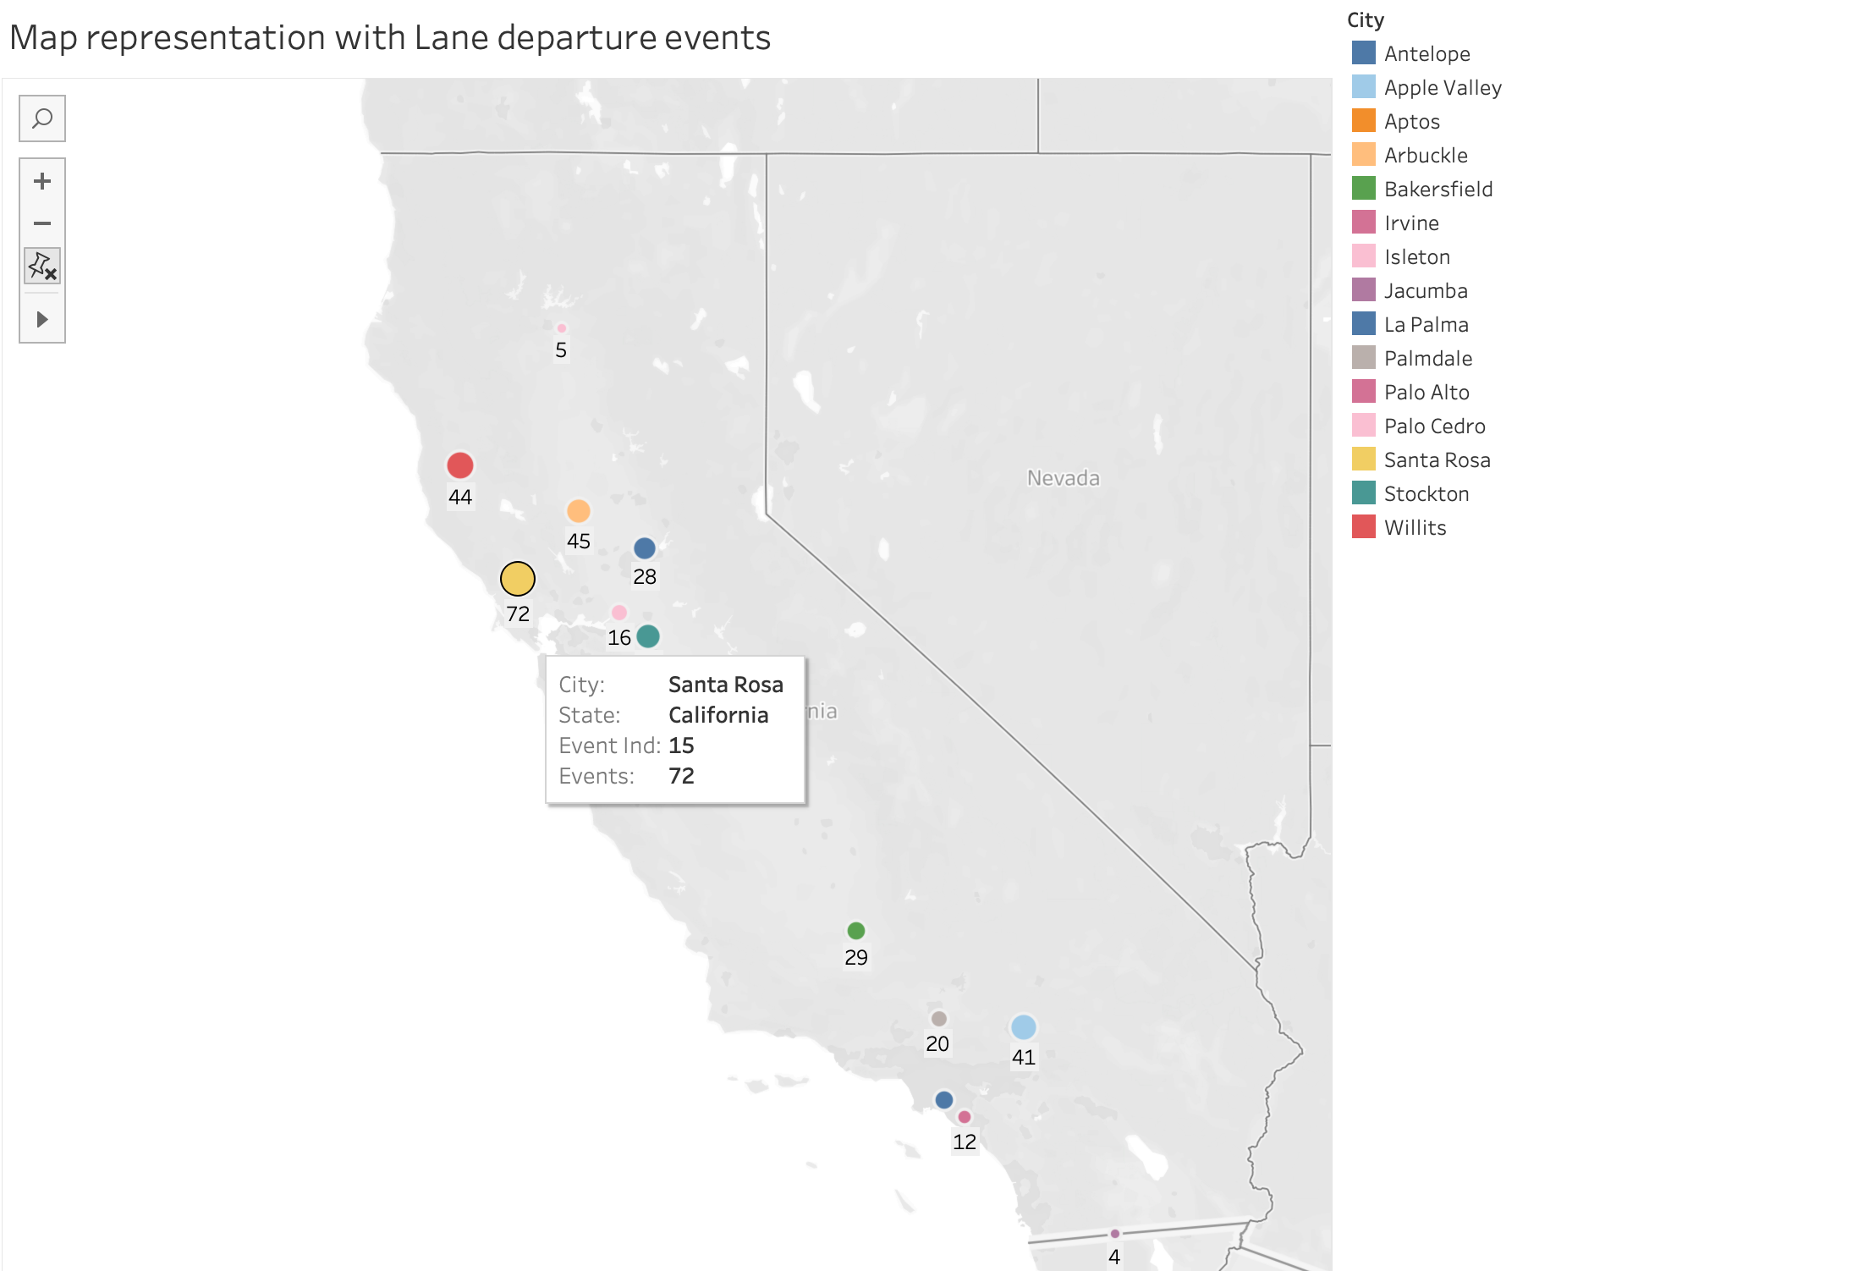
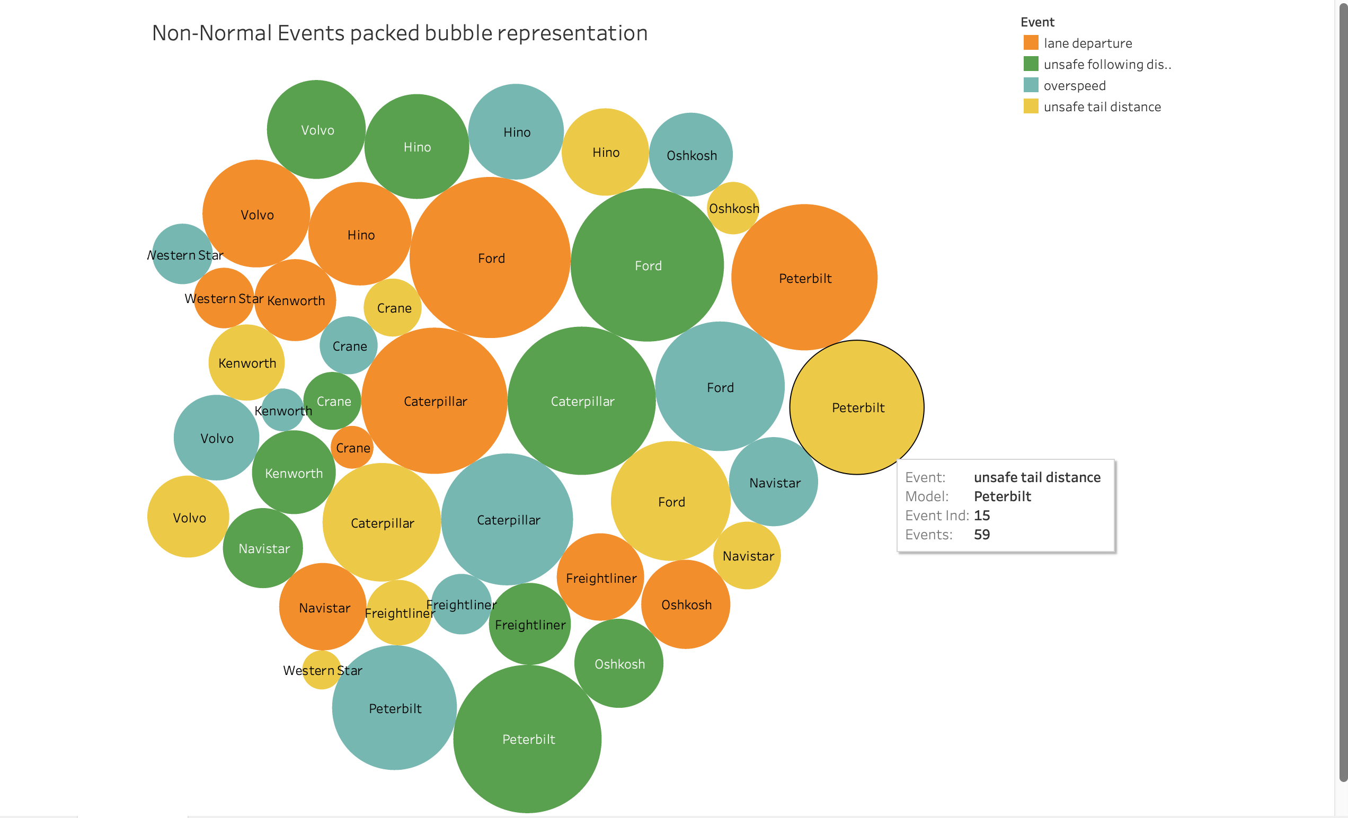
Story 3: Overview of most significant non-normal event
Top 15 California Cities with Highest Lane Departure Events, have been represented:
Santa Cruz Leads with 72 events
Ford, Caterpillar, and Peterbilt are the
vehicles warranting close monitoring
Lane departure events by the models:
Ford - 30
Caterpillar - 26
Peterbilt - 23

Slide 8
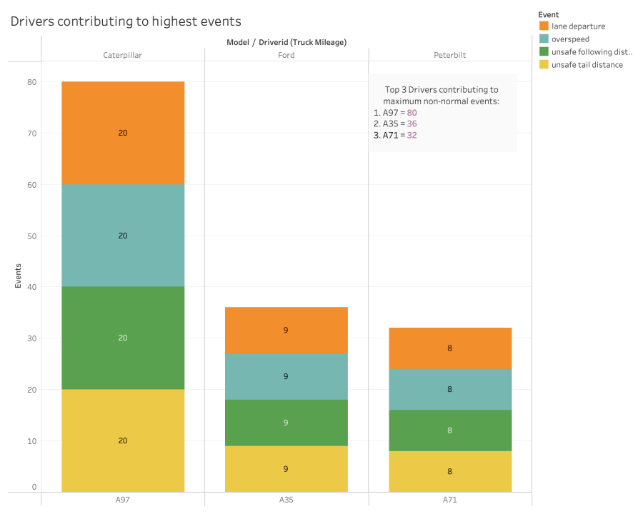
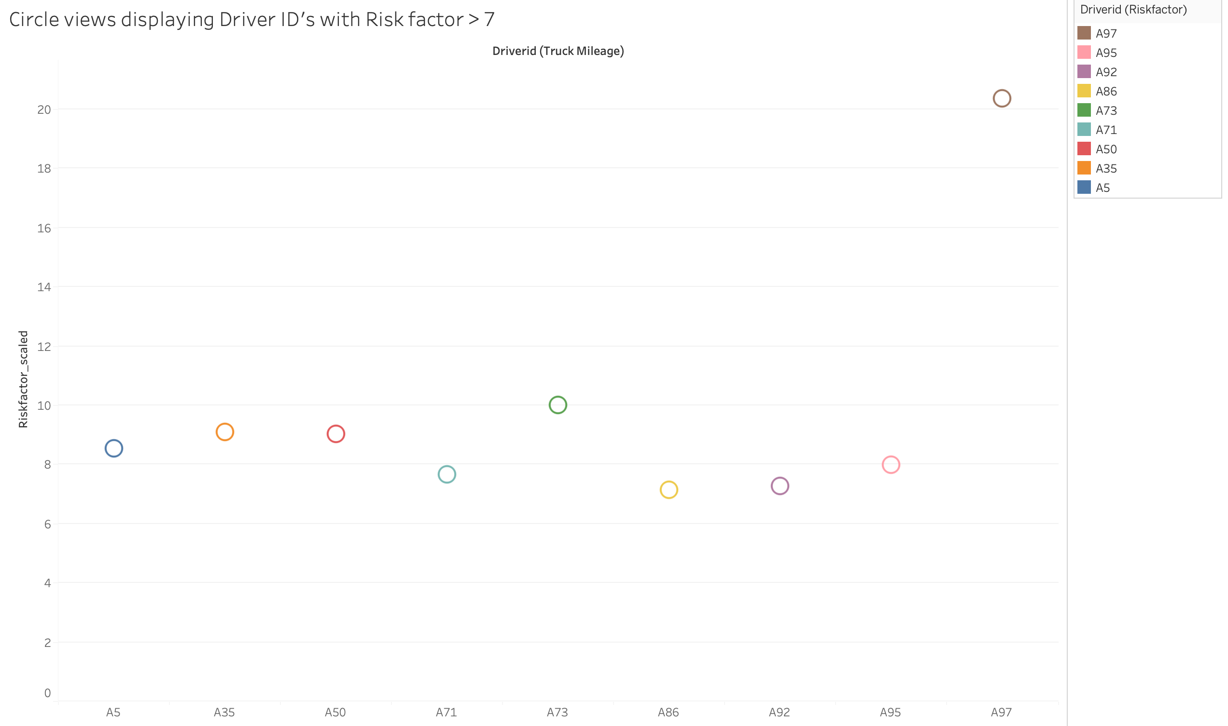
Story 4: Drivers responsible for the highest number of events
Top 3 Driver ID’s contributing to most of the non-normal events:
A97 – 80 (10 % of total )
A35 – 36 (4.7 % of total)
A73 – 32 (4.2 % of total)
When Focusing on Driver IDs with Risk
Factor > 7
A97 proves to be the outlier however with a Risk factor of 20.35

Slide 9
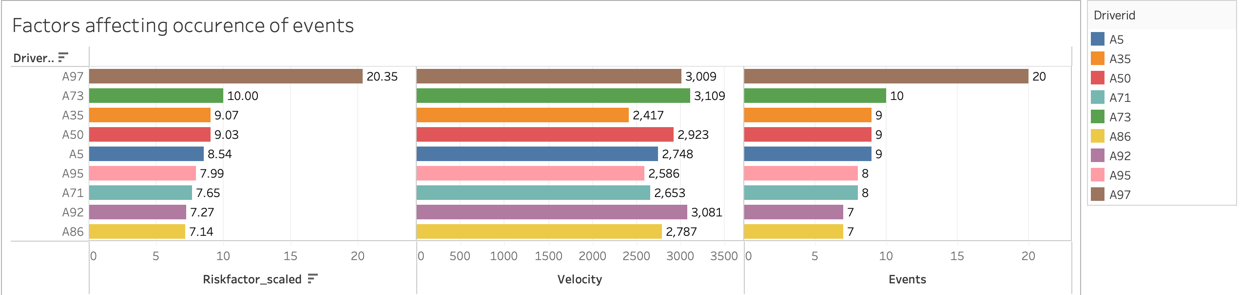
Story 4: Drivers responsible for the highest number of events (cont.)
Driver IDs with risk factor > 7 have been presented above
The speed (velocity) of the vehicle is a significant contributing factor to lane departure
incidents.
Following A97, it is evident that Driver ID A73 requires particular attention to effectively reduce accidents.

Slide 10
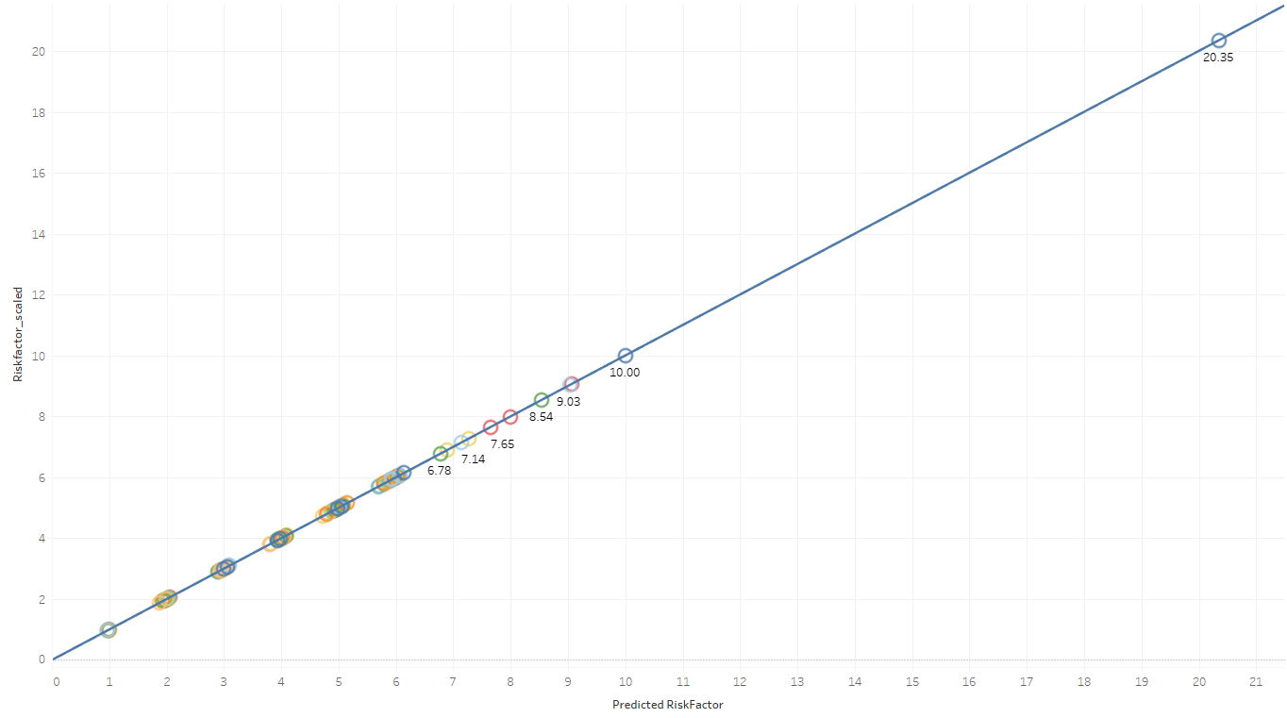
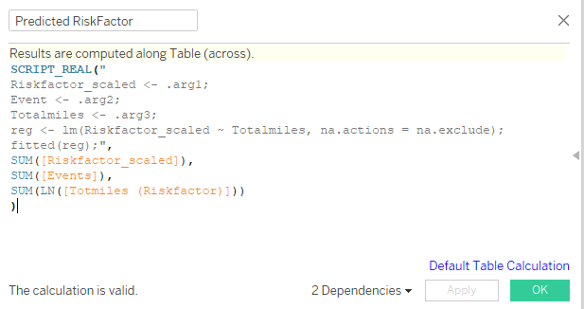
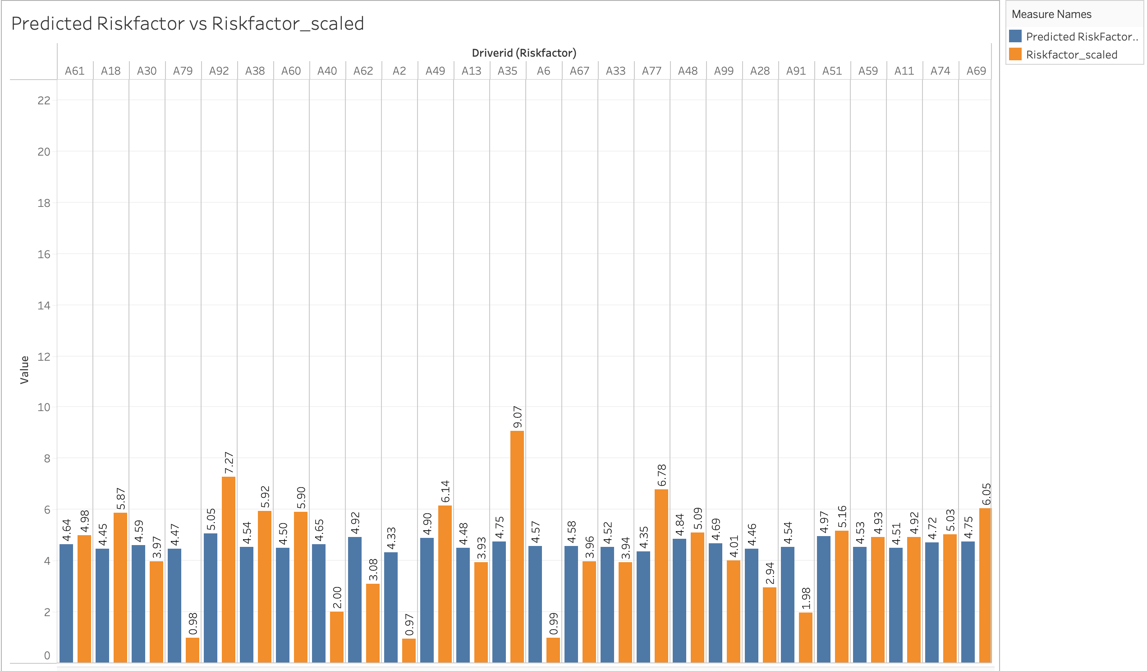
R Analysis
The given code predicts the values of the dependent variable “Riskfactor_scaled" based on a linear regression model using the independent variable "Events".
The values of "Riskfactor_scaled" can be reasonably estimated using a straight line that best fits the data points based on the values of "Events.”
A positive slope indicates that as the values of "Events” increase, the values of "Riskfactor_scaled" also tend to increase.

Slide 11

Challenges
R integration for MAC:
Compatibility and Configuration
R Package Management
Security and Permissions
Dimension selection for the linear model:
Domain Knowledge
Multicollinearity
Dimension Transformation
Notes:
There are two major challenges that we have , the first one is integrating with R for MAC users. While integrating , we faced compatibility and configuration issues as Setting up R integration in Tableau for Mac might be more challenging compared to Windows. Also, Managing R packages and their dependencies might be different on Mac than on Windows. Ensuring that the required R packages are installed and accessible to Tableau can be a challenge. Security and permissions issues such as On macOS, security settings may prevent Tableau from executing R scripts by default. Users might need to grant appropriate permissions or modify security settings to allow Tableau to interact with R.
Another major challlenge is Dimension Selection for Linear Model. Choosing relevant dimensions for a linear model requires domain knowledge and understanding of the data. Selecting irrelevant or redundant dimensions may lead to a model with poor predictive power. Also, if selected dimensions are highly correlated with each other, it can cause multicollinearity issues in the linear model, leading to unstable coefficient estimates. Sometimes, linear models may perform better when certain dimensions are transformed (e.g., log-transformed) to meet the assumptions of the model. Identifying when and how to transform dimensions can be challenging.

Slide 12
CONCLUSION
1. Top 3 Trucks Contributing to Accidents are Ford, Peterbilt, and Caterpillar.
2. Ford - Highest Risk Factor.
3. Santa Rosa - Highest Lane Departure Events.
4. A97 - The Outlier
5. Focus on A73 after A97
6. Correlation Between Events and Risk Factor
Notes:
Top 3 Trucks Contributing to Accidents: The analysis indicates that Ford, Peterbilt, and Caterpillar are the top three truck manufacturers that contribute the most to accidents. These trucks may warrant special attention in terms of safety measures and regulations.
Ford Has the Highest Risk Factor: Among the identified truck manufacturers, Ford stands out with the highest risk factor. This suggests that Ford trucks might have a higher likelihood of being involved in accidents compared to the others.
Santa Rosa Leads in Lane Departure Events: The data reveals that Santa Rosa has the highest number of lane departure events, indicating a potential area of concern in terms of road safety and lane adherence.
A97 Identified as an Outlier: A97 is identified as an outlier in the dataset. This could imply that it exhibits significantly different behavior or characteristics compared to other data points, warranting further investigation.
Focus on A35 after A97: Following A97, A35 is suggested to be the next area of focus to improve event statistics. This indicates that A35 might have notable safety issues that need attention to reduce accidents or events.
Correlation Between Events and Risk Factor: The analysis shows that there is a positive correlation between the number of events (e.g., lane departure events) and the risk factor. This means that as the number of events increases, the risk factor also tends to increase, suggesting a potential relationship between these variables.

Slide 13
THANK YOU

